Slide 1

Are smart contracts haunted?
A tour through the most popular smart contract vulnerabilities.

Slide 2
Agenda
Intro
Most common vulnerabilities
Examples
Outro

Slide 3

Introduction
Adrian Hetman
Triaging Tech Lead at Immunefi
Content creator
Previously worked as an auditor
For few years worked as a smart contract developer

Slide 4
Common smart contract vulnerabilities
01
Unsafe external calls
02
Usage of spot-price
03
Authentication issues

Slide 5
Types of unsafe external calls

Slide 6

External calls
Calls to 3rd party address that we do not control
If the recipient is controlled by an attacker, every external call is potentially dangerous because the attacker may be able to force your contract to transition into an undefined state.

Slide 7

Re-entrancy attack
It’s an attack where a malicious user recursively calls a vulnerable function to steal funds.
That was the attack vector behind the DAO Hack in 2016.

Slide 8
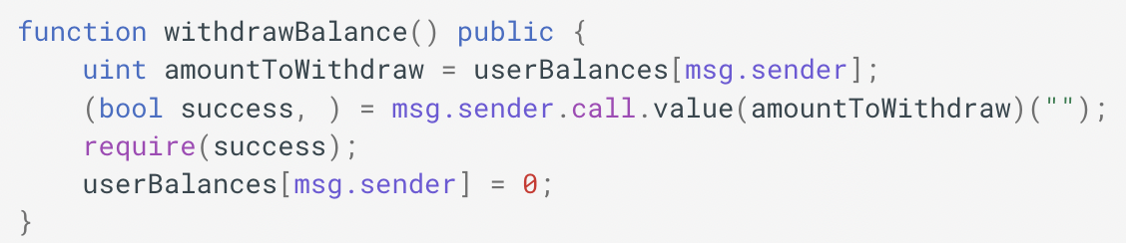
Example re-entrancy attack

Slide 9
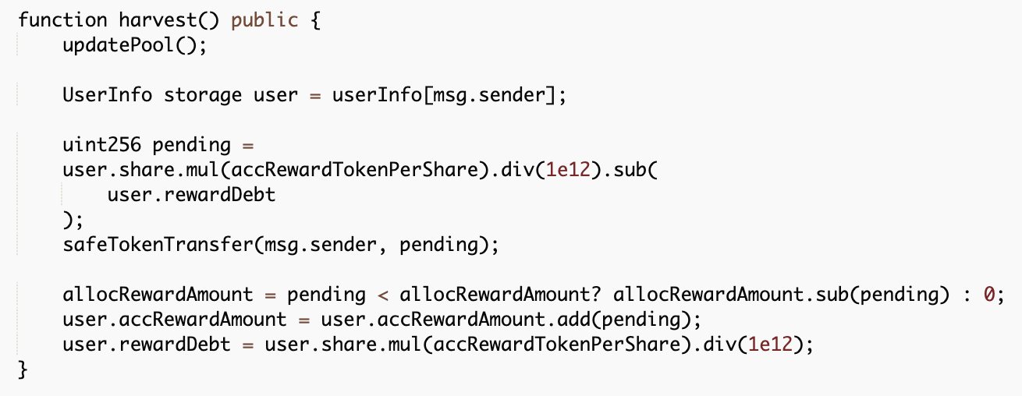
Re-entrancy example in an AMM project

Slide 10
Re-entrancy example in an NFT project
In the implementation, the safeTokenTransfer isn’t actually safe.
Underneath the function is an external call to the 3rd party address, which is controlled by the attacker, and we give up control to him by sending unwrapped ETH to it.
The vulnerability occurs because the user.rewardDebt variable is updated AFTER sending the token to the user.

Slide 11

Uninitialized proxy bug
This bug can lead to the self-destruction of the implementation contract, which could render the proxy contracts useless.
This is because of the upgradeable proxy pattern used: one with the upgrade logic residing within the implementation contract rather than the proxy.

Slide 12
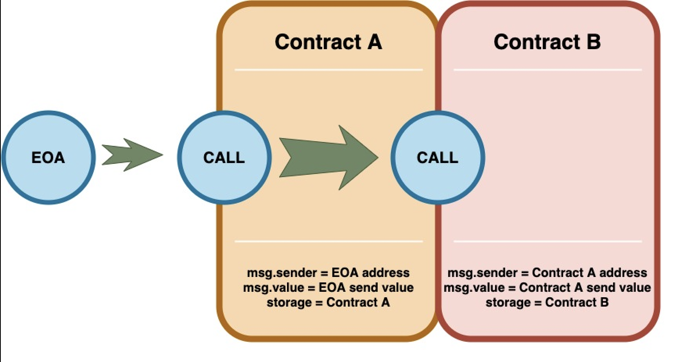
Call

Slide 13
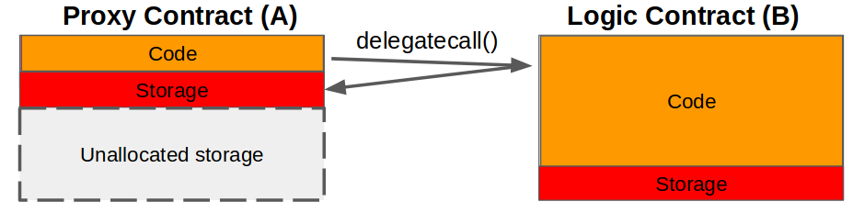
Short intro to delegatecall and selfdestruct
The proxy contract redirects all the calls it receives to an implementation contract, whose address is stored in its (Contract A’s) storage.
The proxy contract runs Contract B’s code as its own, modifying the storage and balance of Contract A.
Selfdestruct removes all bytecode from the contract address

Slide 14
Constructor() vs Initialize()
Constructor is a function that is run during contract creation.
Initialize is function that has been created to “replicate” constructor logic for proxy contract usage.

Slide 15
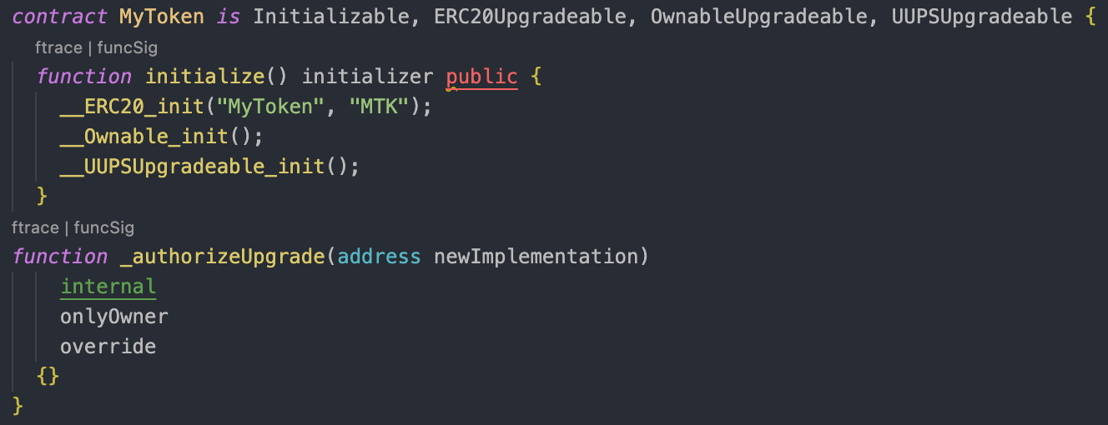
OpenZeppelin’s UUPS uninitialized proxy bug
Notes:
Explain constructor vs initialize

Slide 16
OpenZeppelin’s UUPS uninitialized proxy bug: explanation
Implementation contract isn’t initialized.
An attacker becomes an owner.
As an owner, the hacker can call upgradeAndCall() directly on the implementation.
upgradeAndCall() calls any migration/initialization function on new implementation using delegatecall().
In a result, the implementation contract executes a malicious function that calls selfdestruct() and renders the implementation contract useless.

Slide 17

Wormhole $10,000,000
Wormhole Uninitialized Proxy BugFix Review

Slide 18
Spot-price usage

Slide 19

Price oracles
A price oracle is a tool used to view the price information of a given asset.
On-chain oracles rely on constant-product AMMs, like UniswapV2 or Balancer.
Users rely on the current ratio of two tokens. For example, the ETH-DAI ratio gives us the current price of an ETH.

Slide 20
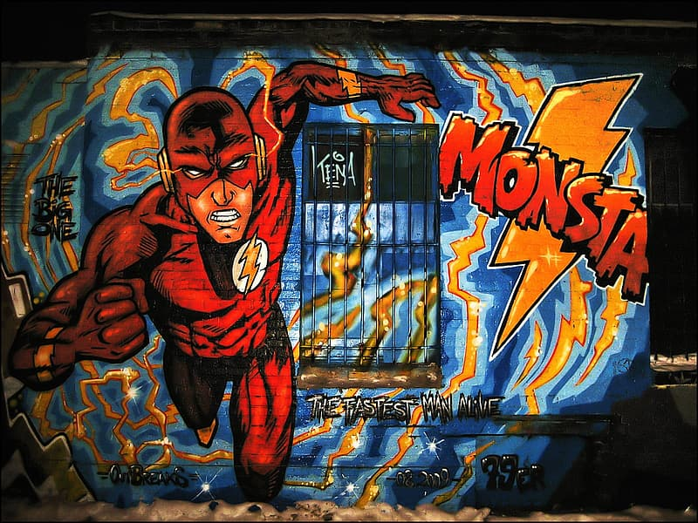
Flashloans
Flashloans are a way to borrow a large amount of money from a lending protocol like Aave without collateralization. The borrower pays a certain fee at the end.
The caveat is it needs to be returned within one transaction. If not, the transaction will be reversed.

Slide 21
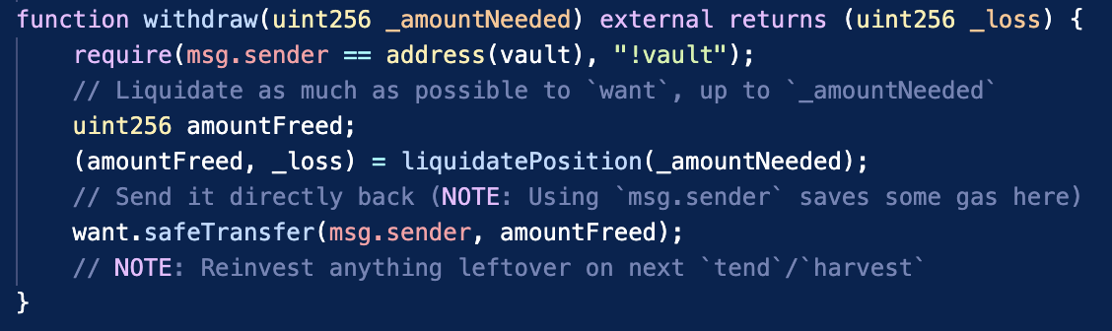
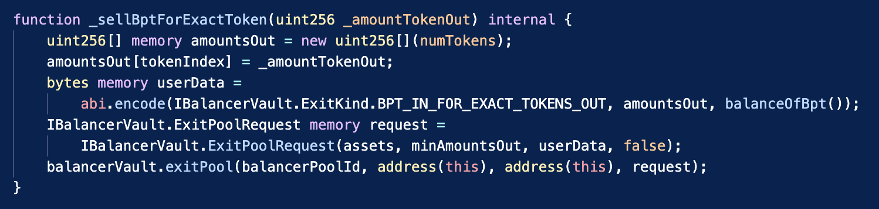
Yearn.Finance spot-price usage
Notes:
Vaults let users hold an asset they like while also earning yield denominated in that asset, so they can grow their stack.

Slide 22
Yearn.Finance spot-price usage - explanation
Flash borrow yvUSDT and DAI from BentoBox.
Buy USDT with DAI at Balancer to imbalance the pool.
Withdraw from yvUSDT. Withdrawal will sell more Balancer LP tokens due to imbalanced pool.
Buy DAI back with USDT to get a profit.
Deposit back to yvUSDT.
Repay flashloan.

Slide 23
Lack of authentication

Slide 24
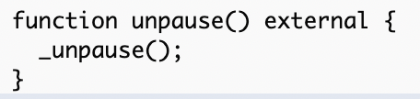
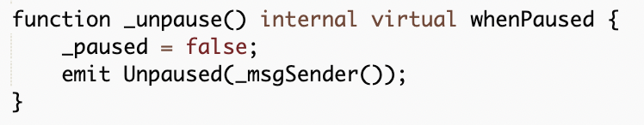
Missing an authorization check

Slide 25
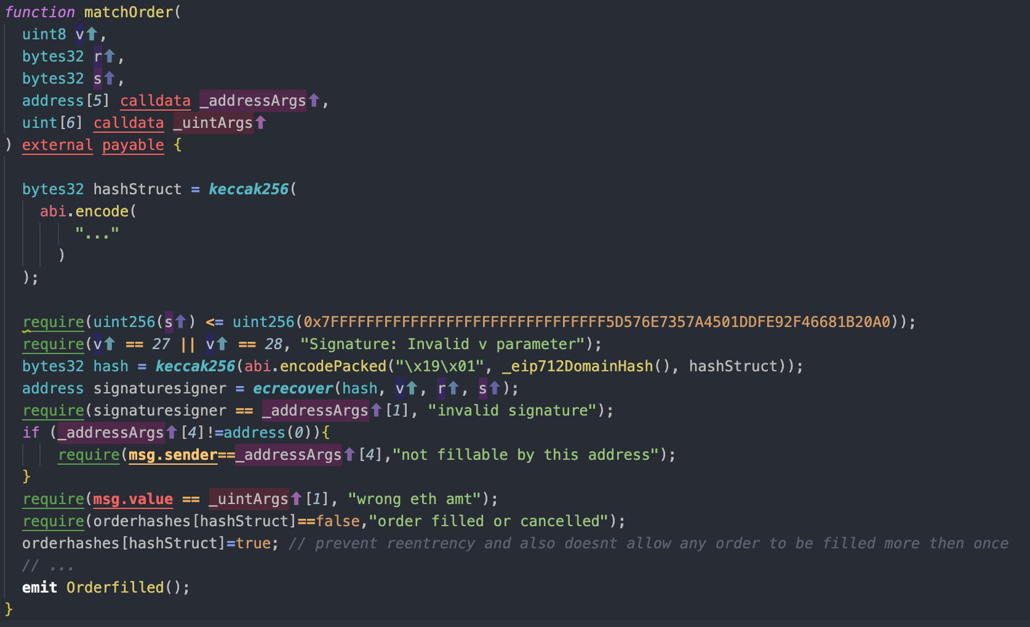
Lack of access control in cancelOrder() #1

Slide 26
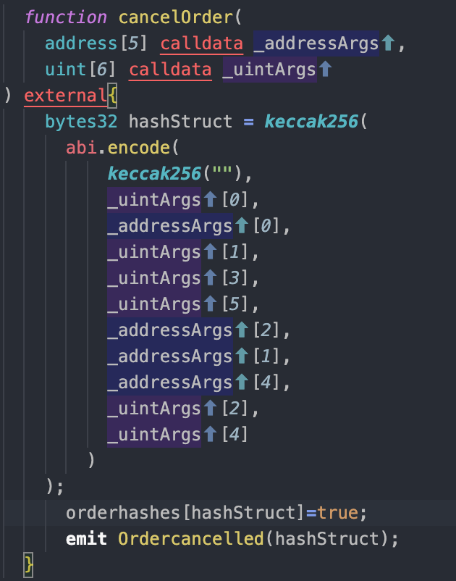
Lack of access control in cancelOrder() #2

Slide 27
Who wants to become a Web3 hacker?

Slide 28
Useful links to get you started
Hacking the Blockchain: An Ultimate Guide
https://solidity-by-example.org
https://github.com/OffcierCia/DeFi-Developer-Road-Map
https://www.damnvulnerabledefi.xyz
https://cmichel.io/how-to-become-a-smart-contract-auditor/
https://www.notonlyowner.com/learn/intro-security-hacking-smart-contracts-ethereum

Slide 29


